Slide 1
ST. ALBANS COST OF LIVING PRESENTATION
NAME
INSTITUTION
COURSE
DATE

Slide 2
INTRODUCTION
This is a police force department based in Franklin county, Northwestern Vermont.
It is tasked with responsibilities such as:
Countering crimes
Conducting security patrols
Responding to emergency situations within the city.
Notes:
The police force is tasked with performing administrative services in conjunction with those highlighted above. From the previous census, statistics show that the City of Albans held a population of 6,392 people. The population density it manifested was around 135.4 per square mile. Therefore this is the current approximate number of people whose security is entrusted to the this police force department.

Slide 3
RISE IN THE COST OF LIVING
The citizens in the entire country have experienced a gradual rise in the cost of living (U.S. Bureau of Statistics Latest Numbers, 2018) .
The officers’ salaries are still the same despite the situation over a decade.
The rest of the police departments have increased their salaries.
The city is therefore not up to the terms of remuneration.
Notes:
The country has been facing economical challenges in the cost of living that has gradually risen over time. This, in other words means that the costs of basic products has risen. However, this particular department has failed. The salaries of these officers remain constant and therefore they are unable to fit in the rising situation of the economy. This basically means that the salaries paid to the officers are not in line with the average national level.

Slide 4
COST OF LIVING; effects
Loss of motivation at work. They loose morale at work because they worry about their families economic situation.
It challenges their living standards. They have too little income therefore they spend almost all of it to cater for basic needs for their families.
Notes:
Their disposable income is too little thus they worry about taking care of their families. The rise in the costs of commodities poses a challenge to the officers in buying them. They have too little to buy everything therefore they end up sacrificing one thing in order to afford the other. This in the end challenges their ability to execute their tasks effectively.

Slide 5
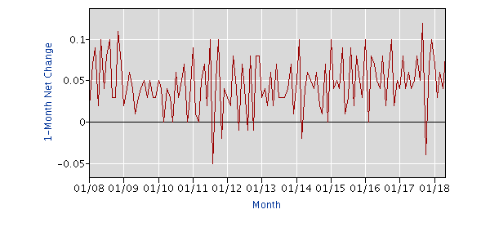
COST OF LIVING; effects
Notes:
According to statistics released by the North American Industry Classification System in May 2018, the earnings of employees in other agencies in the non farm payroll increased. The graph above shows the increase in changes in earnings from 2008-2018 over a one month net change. By May 2018, thre was a 0.8 change in margin of the current earnings. This means that other agencies have increased their average national level earnings; basically what the City of St.Albans police force has not been able to do.

Slide 6
COST OF LIVING; effects
Their core responsibility is maintenance of law and order.
They cannot perform their duties effectively with low motivation. Criminals are likely to take advantage of this.
This will compromise security in the city since there is a possibility that crime rate will increase.
Notes:
The officer might find it challenging to report to duty due to the poor economic situations at home. This means that the ability to even respond to emergency situations might be compromised. This is because they might not be within reach whenever such a situation occurs. The response rate could also end up being too slow.

Slide 7
CONCLUSION
There is really need to consider raising their salaries to the average national level.
It should be equal to that of other officers within the state.
This will motivate them and enhance performance.
The union should negotiate for the salary increment.(Learn-About-Unions/Collective-Bargaining, 2018)
Notes:
Two thirds of public sector employees have a right to collective bargaining. Therefore this force, being a unionized force, should have a salary raise effected through collective bargaining negotiations by its union. If their salaries are increased to the average national level, this will enable them manage the high state of the economy. They will henceforth decently afford to take care of their families. They will from there have no reason to slow down or neglect their duties. An increase in their salaries will be a guarantee to an effective and efficient police force in the city.

Slide 8
References
http://www.aflcio.org/Learn-About-Unions/Collective-Bargaining
Https://www.bls.gov/U.S. Bureau of Statistics Latest Numbers
Prieb, M. (2013). The wagon and other stories from the city. Chicago: University of Chicago Press.
Sherburne, M. A. (2014). The St. Albans Raid: Confederate attack on Vermont.

